Slide 1
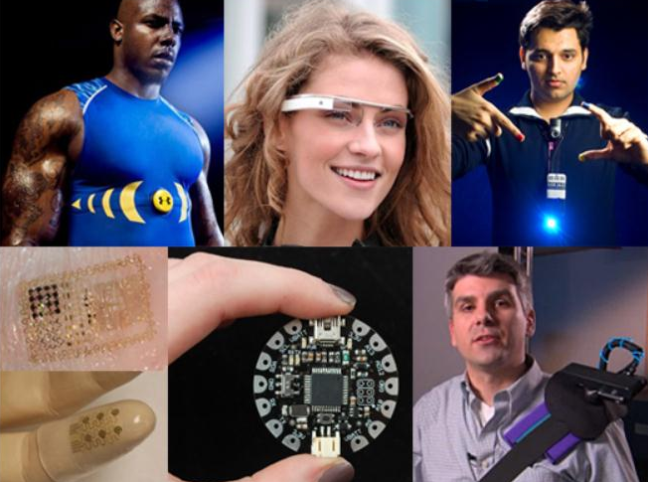
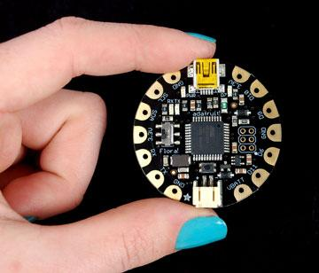
Wearable Electronics 3 Hour Summer Camp – Grade 6-8 Day 1

Slide 2
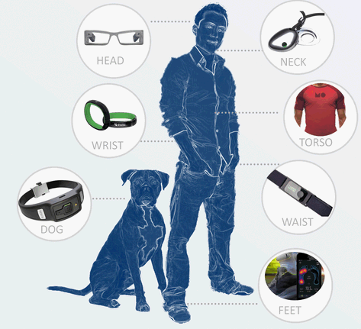
What are Wearable Electronics?
Our bodies are our primary interface for the world!
Interactive systems that live on the body can be upfront, intimate, literally on your face.
They can sit close to your skin, in your clothing and sometimes might feel like part of you!

Slide 3
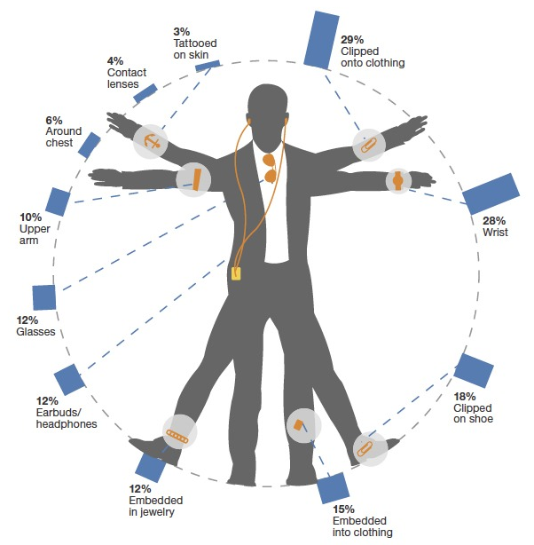
What do people think about Wearable Electronics?
In a survey of 5000 adults in the US (a year back) people were interested
in various wearables as shown here.

Slide 4
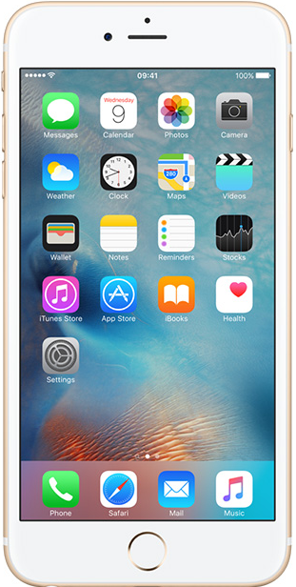
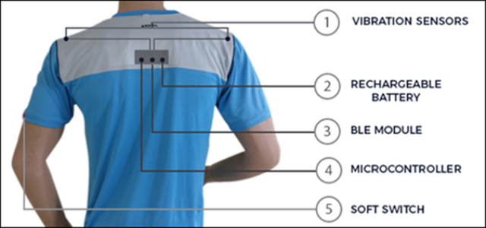
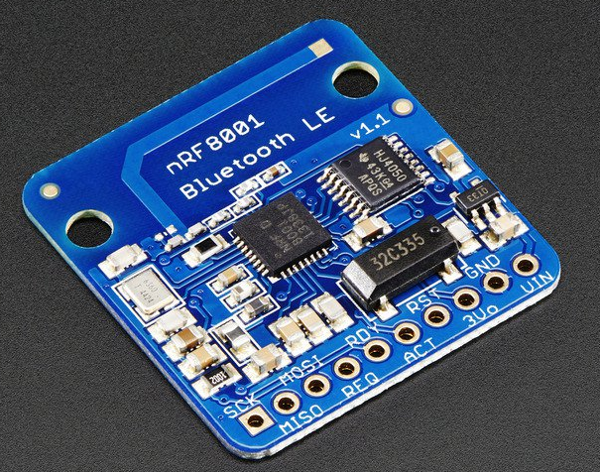
Anatomy of a sample Wearable device
Update App on phone
Bluetooth Low Energy
MOST IMPORTANT PART of a Wearable

Slide 5
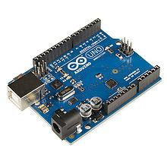
What are Microcontrollers?
Arduino is an open source computer hardware and software company, project, and user community that designs and manufactures single-board microcontrollers and microcontroller kits for building digital devices and interactive objects that can sense and control objects in the physical world.
Circuit Playground from Adafruit features an ATmega32u4 micro-processor. It also is round and has alligator-clip pads around it. You can power it from USB, a AAA battery pack, or Lipoly (for advanced users). Program your code into it, then take it on the go.

Slide 6
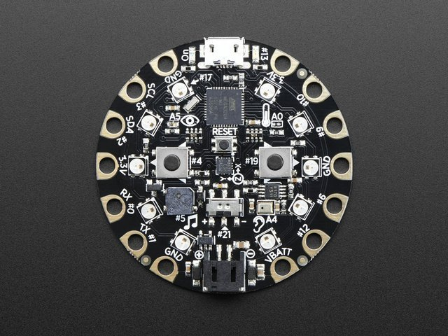
Introducing Circuit Playground
Circuit Playground is the name of the little round electronic circuit board that you are going to use as a tool to investigate and explore programming & electronics. Think of it as like a Swiss Army Knife or multi-tool for learning electronics as an art form! It is an all-in-one board so you can jump in quickly and do a whole lotta projects (It can slice, it can dice, it has lots of blinky LEDs!)

Slide 7
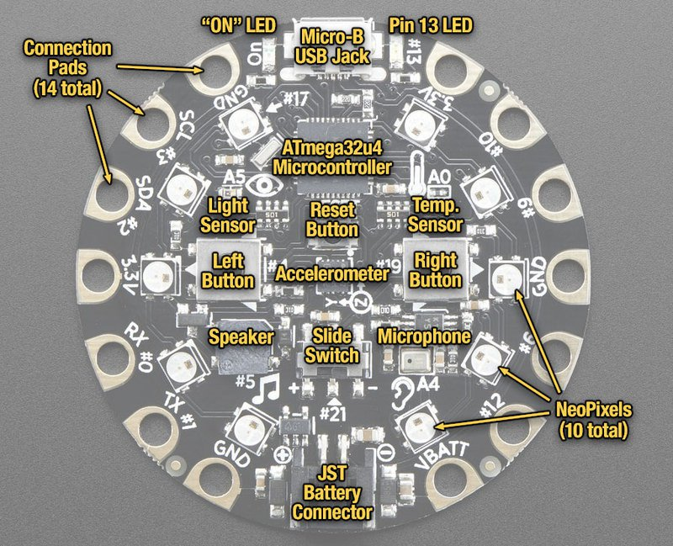
Introducing Circuit Playground

